Slide 1


Slide 2
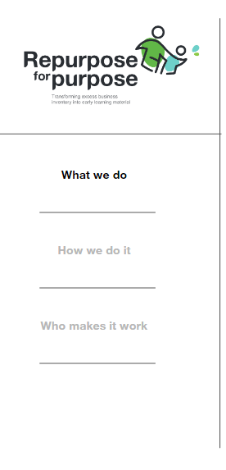

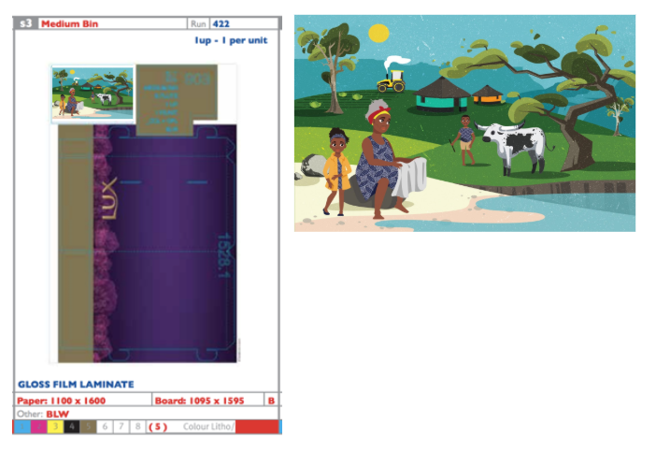
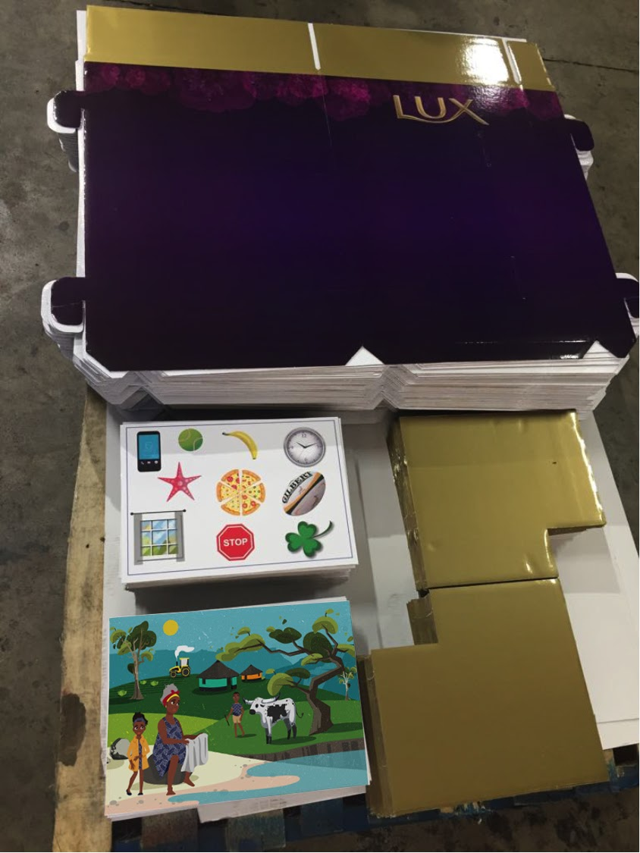
1
2
3
4
5

Slide 3
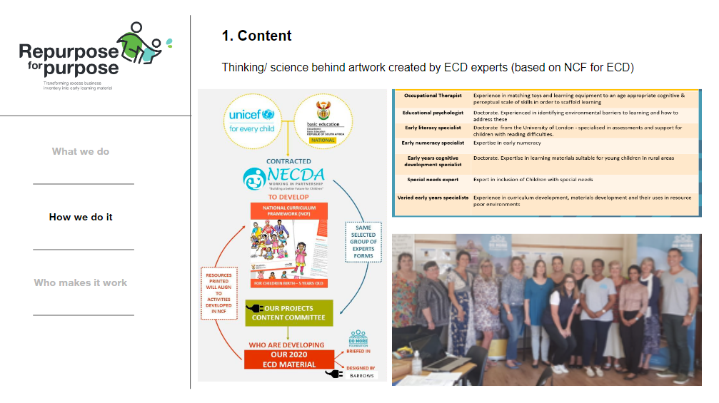

2020 Content
Age & stage
based cognitive development grid
National
Curriculum Framework guidelines
Aligned to
ELDA’s
Content committee ECD specialists and experts
2020 RESOURCES

Slide 4
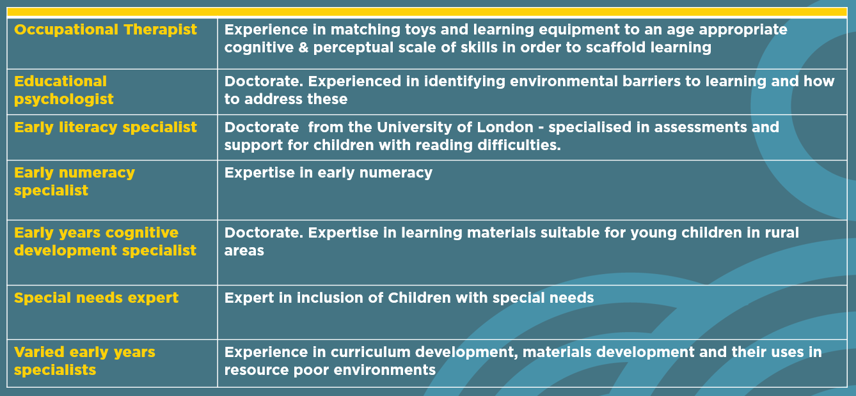
2019/2020 Content committee
Content Committee selected for their expertise and experience and almost all come from organisations that are members of NECDA

Slide 5
EARLY LEARNING MATERIALS - COGNITIVE DEVELOPMENT
1
WHAT WE PRODUCE = RESOURCE | NOT A PROGRAMME IN ITSELF
SCAFFOLD LEARNING
2
LACK OF ACCESS TO INEXPENSIVE COGNITIVE MATERIALS
MAKE THESE RESOURCES FREE
3
NEED FOR TRAINING AND PLAYBOOKS TO ENSURE GOOD USE
4
WORKING TOWARDS NATIONAL REACH WITH NECDA
YOUNG CHILDREN (UNDER 5 YEARS OLD) FROM IMPOVERISHED COMMUNITIES
5

Slide 6

Executive functioning and cognitive
competencies we aim to address
Problem solving
Cognitive flexibility
Perceptual skills
Memory recall
Reasoning skills
Verbal reasoning
“Incidental” learnings as a result of above
Emotional functions
Openness to learn
Socialise to think and reason
Understanding of basic shapes, numbers and concepts
Numbers – grasping quantities
Fine motor skills
Following instructions

Slide 7

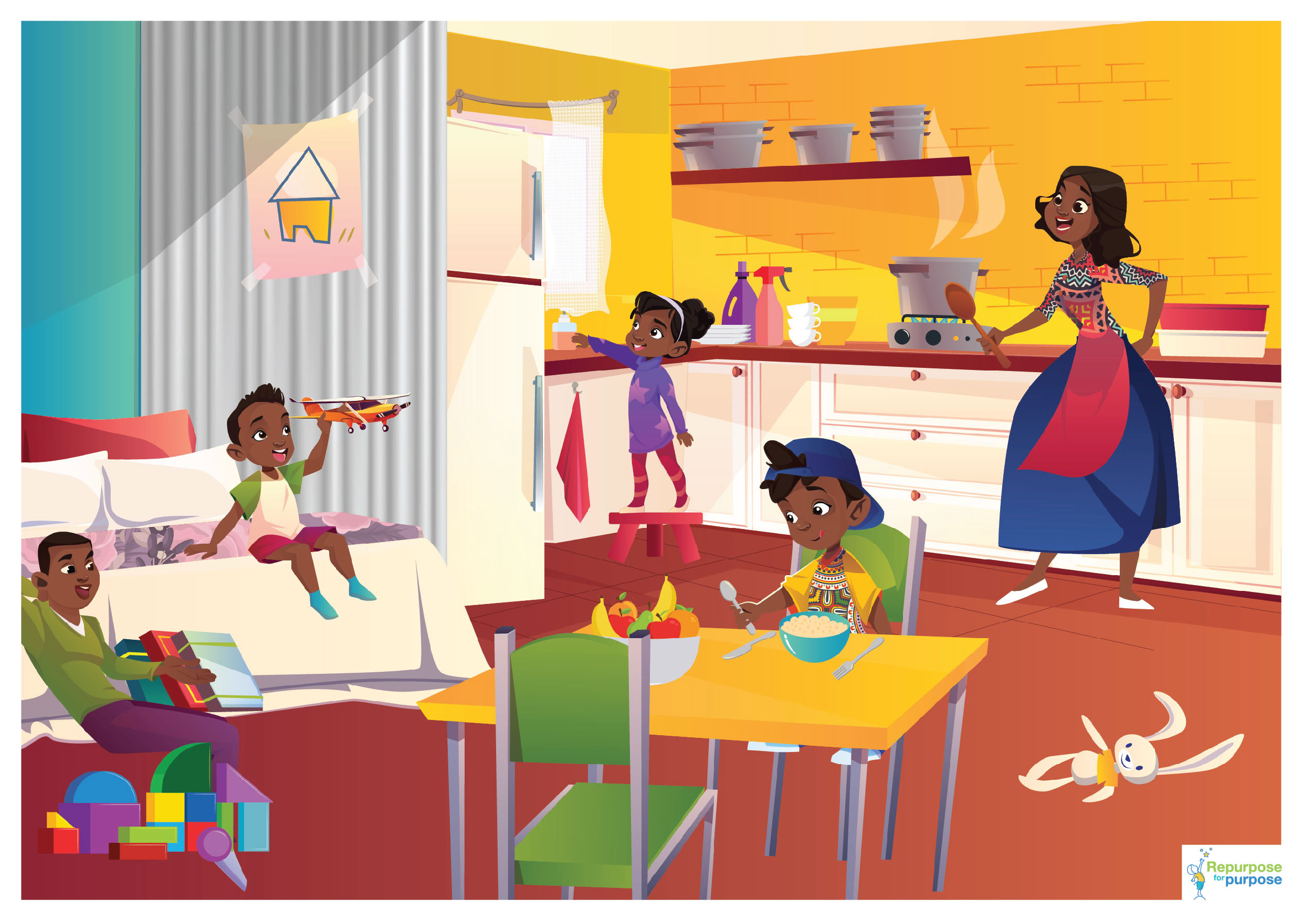






Picture boards and puzzles

Slide 8


Covid-19 education picture boards

Slide 9
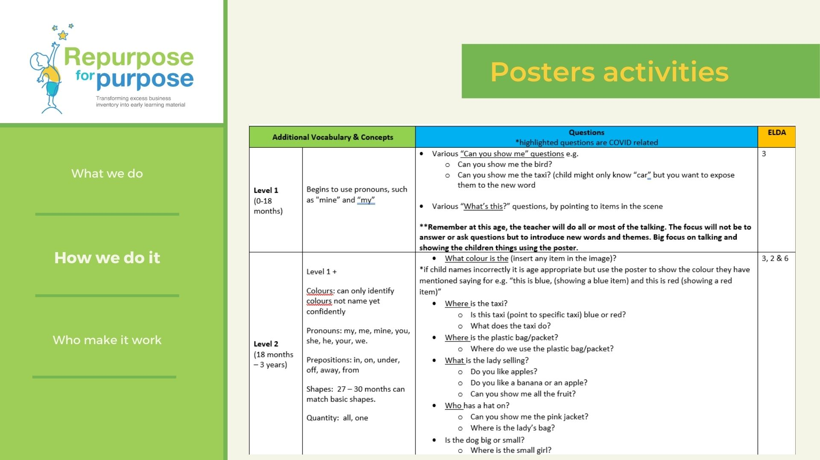
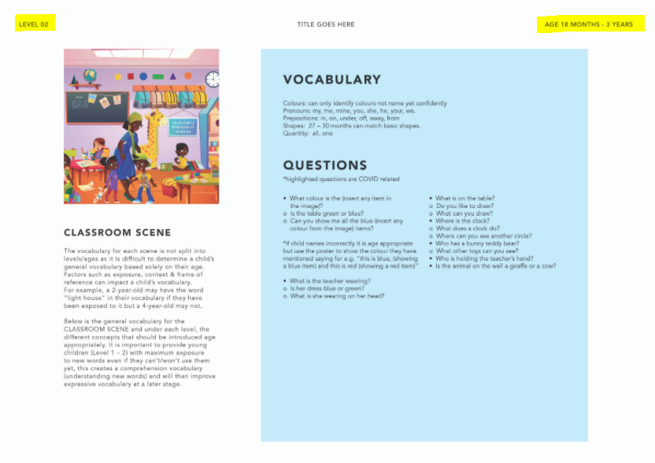
Picture boards activities (playbook)
Picture boards
LEVEL
AGE
ELDA’s

Slide 10
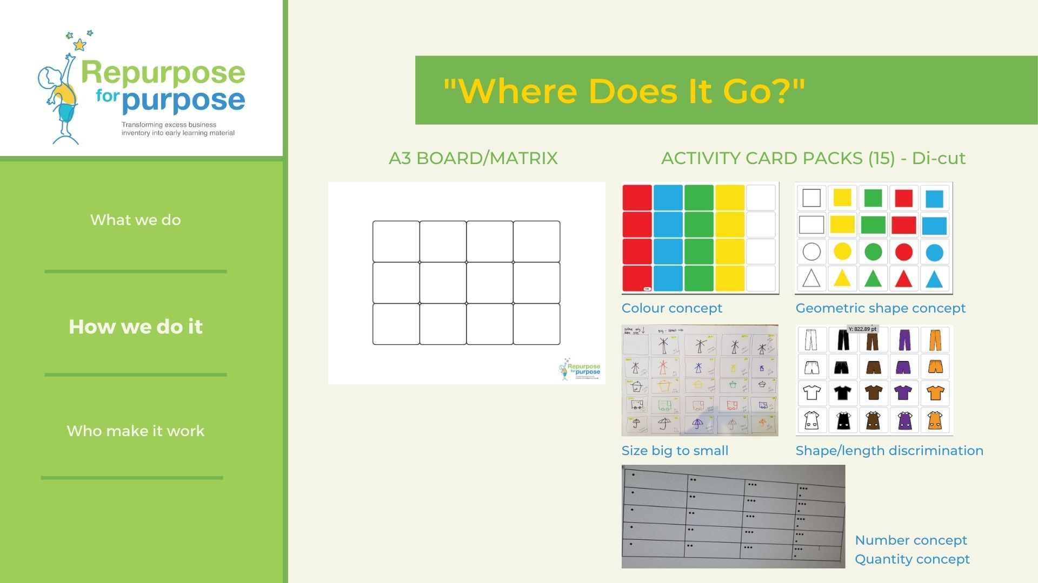
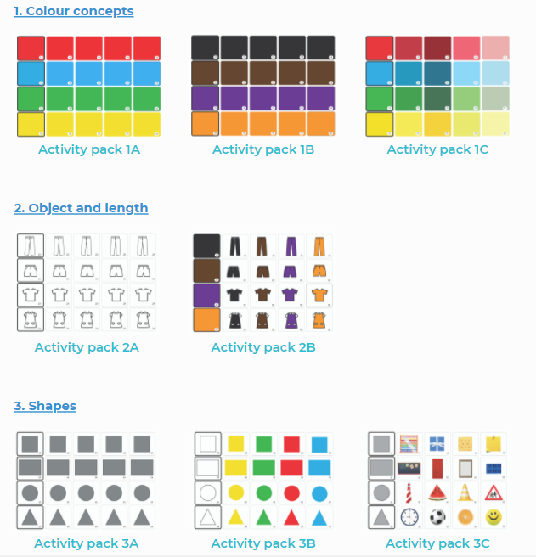
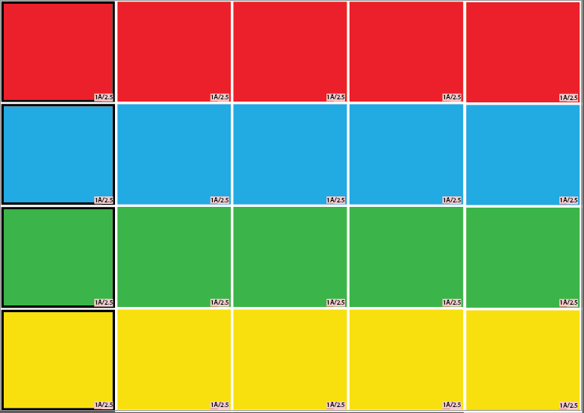
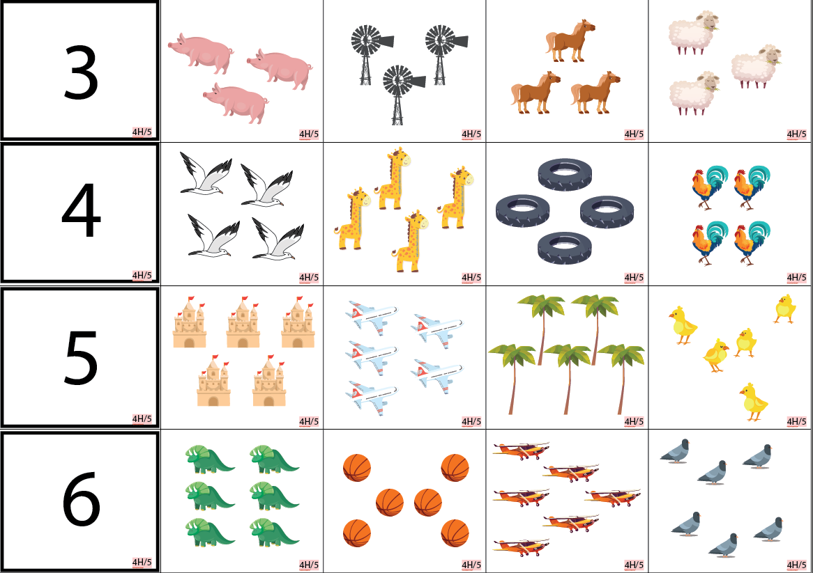
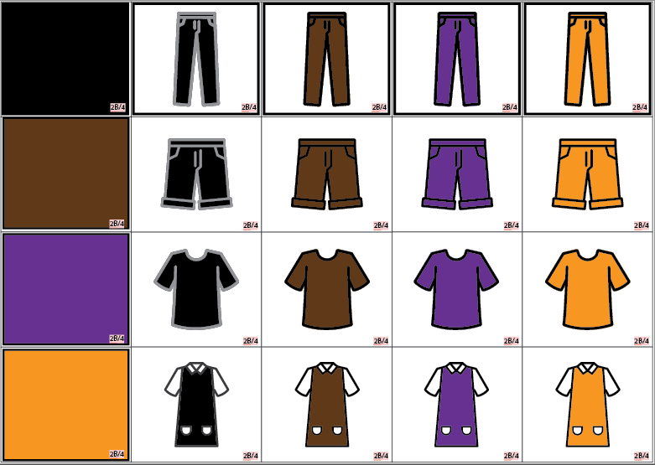
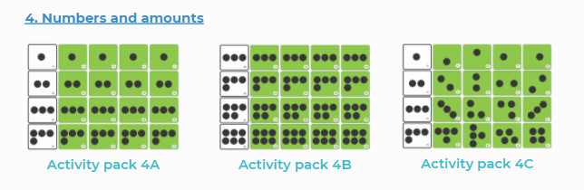
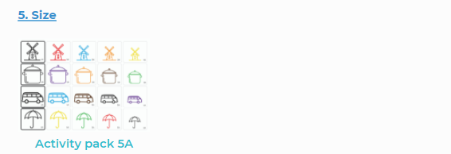
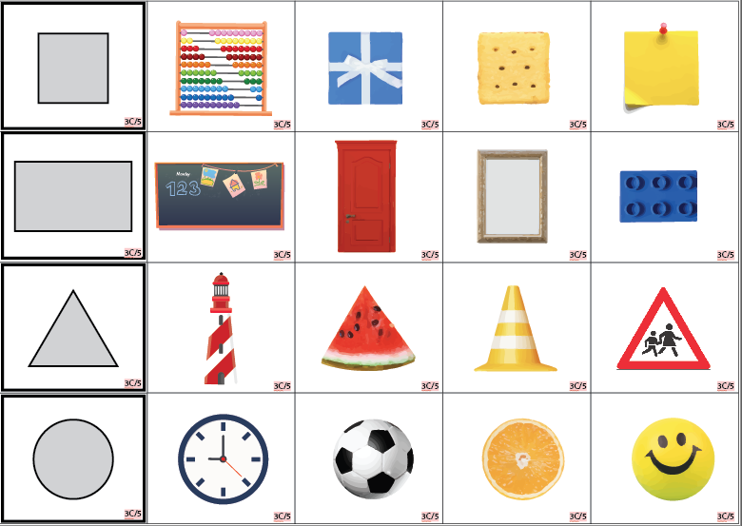
Where Does It Go?
A3 Base Board

Slide 11


Slide 12
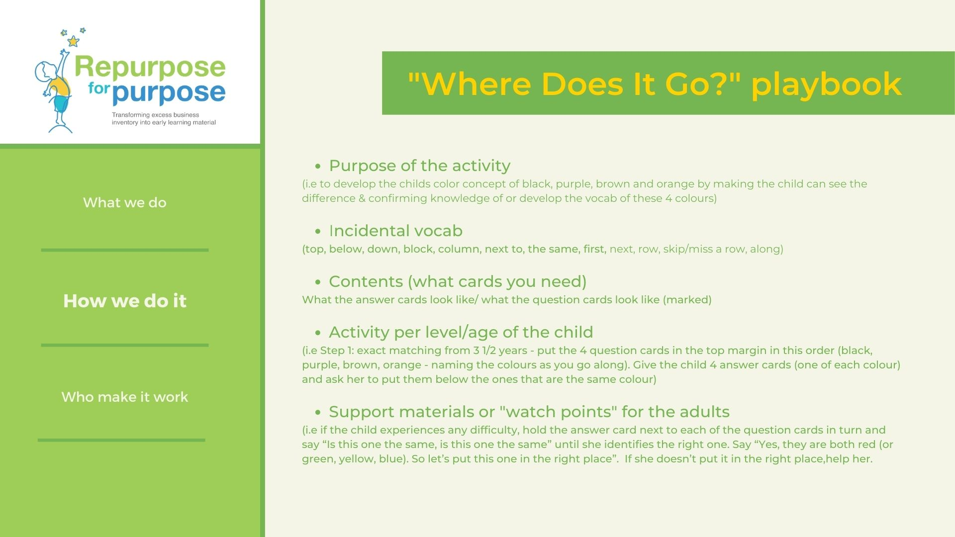
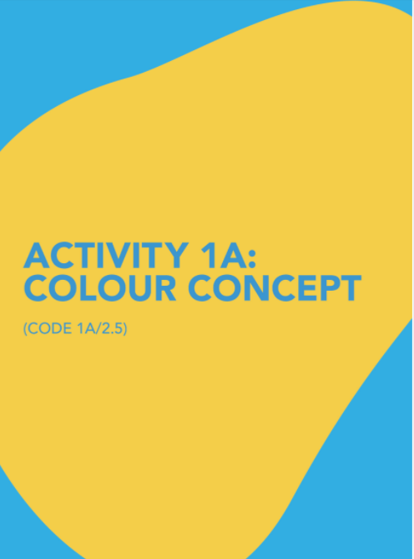
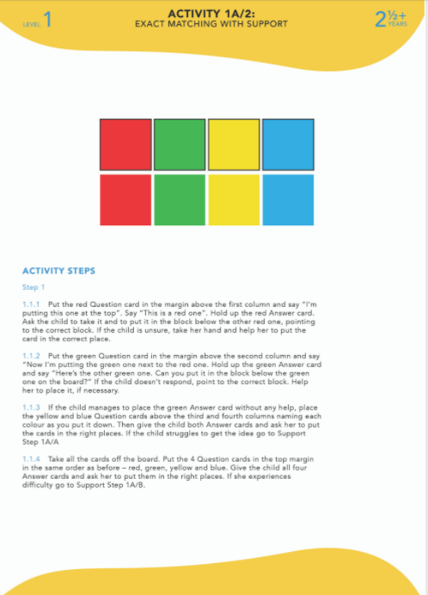
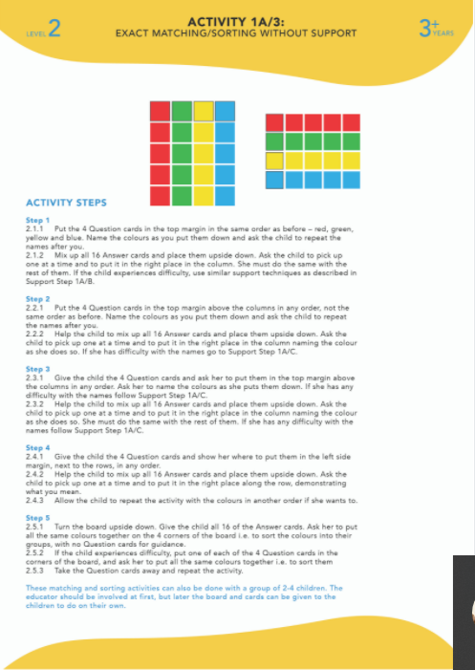

Slide 13
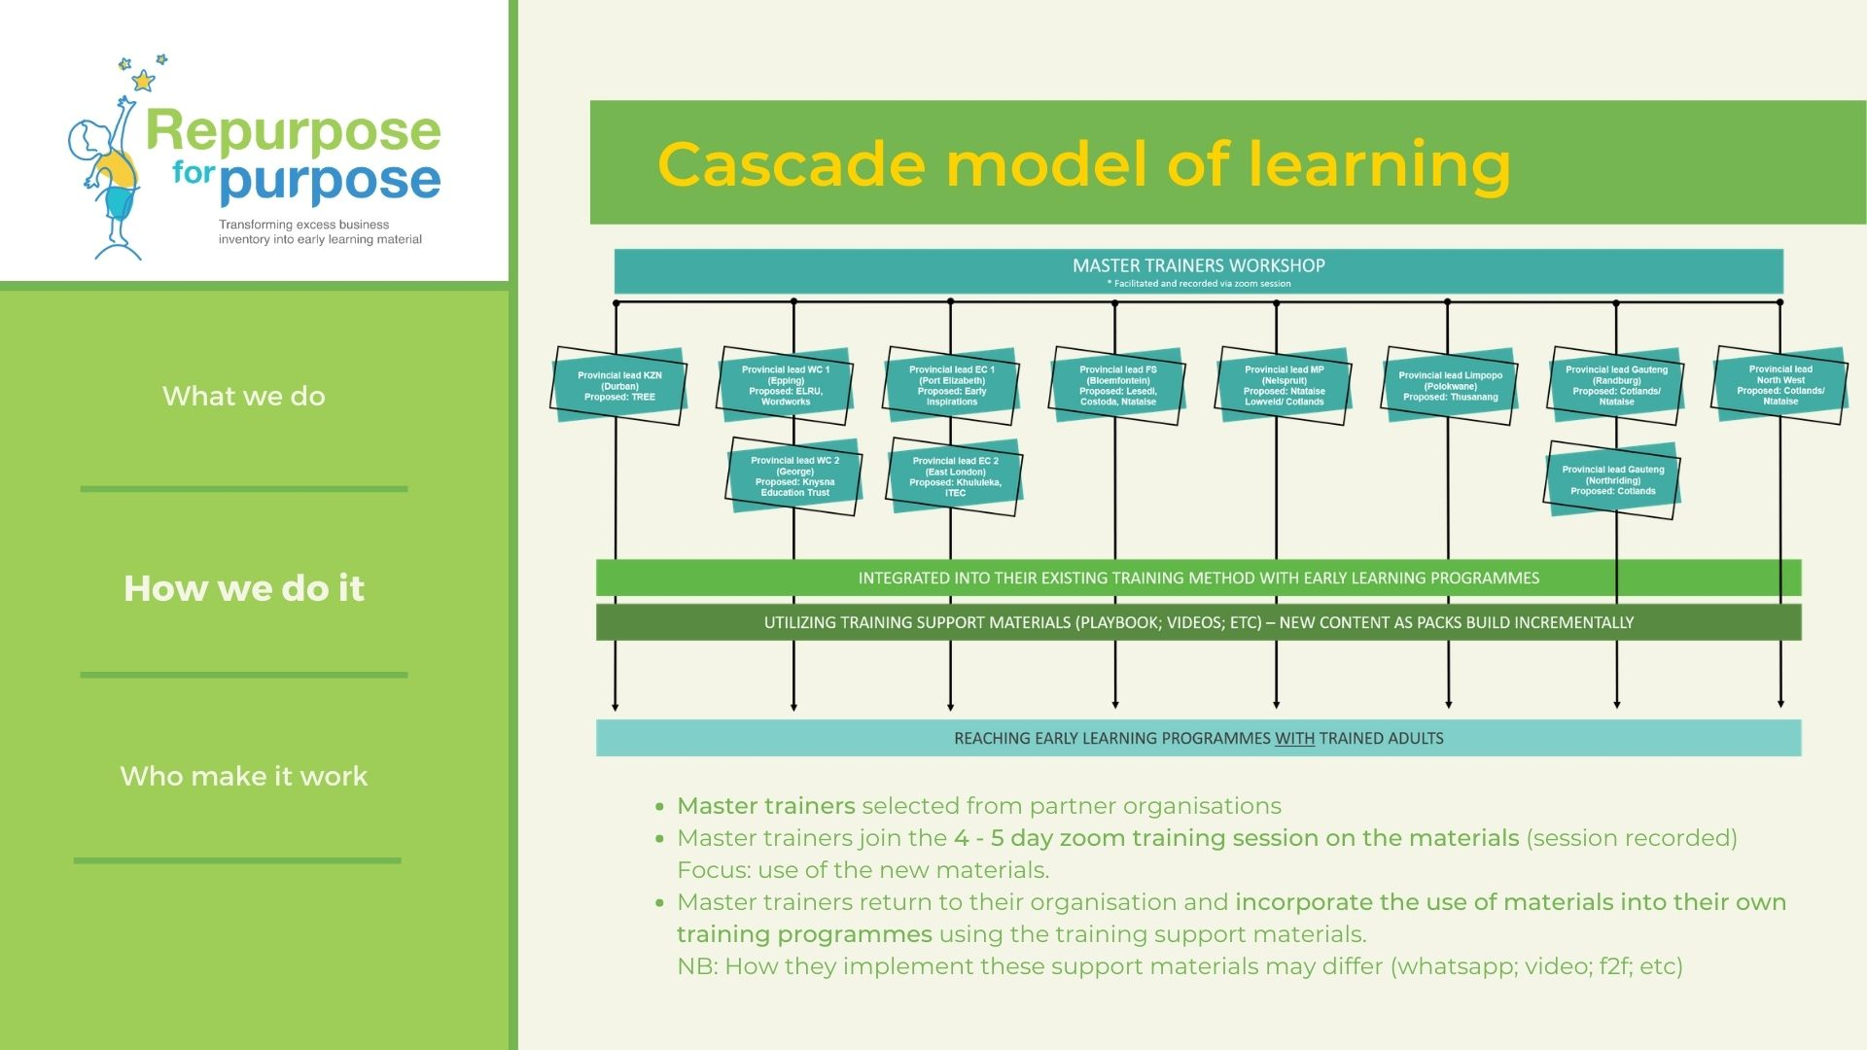
Master trainers' workshop
Integrated into their existing training method with practitioners
Training support material provided to master trainer for practitioners
End results: resources reach early learning programmes with trained practitioners

Slide 14
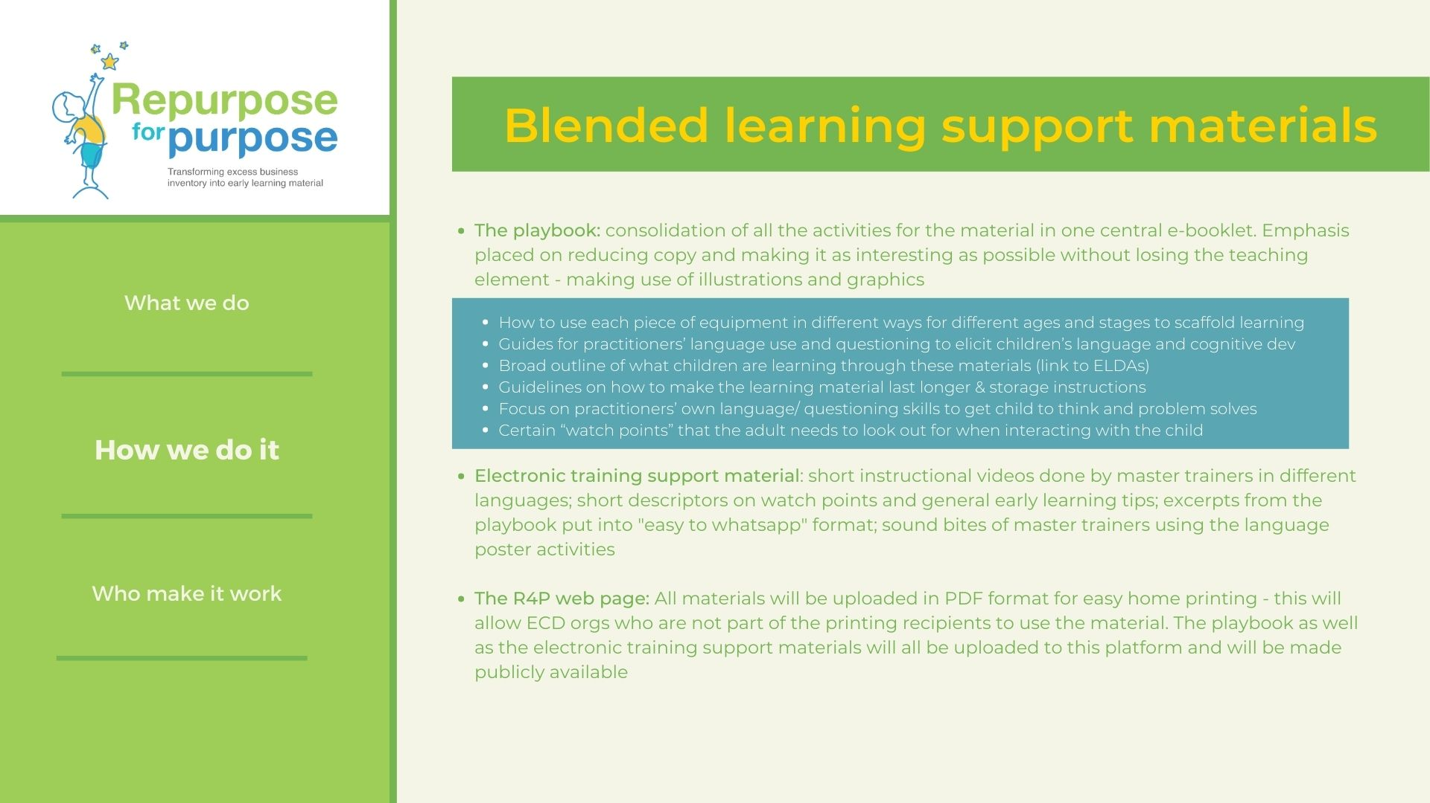




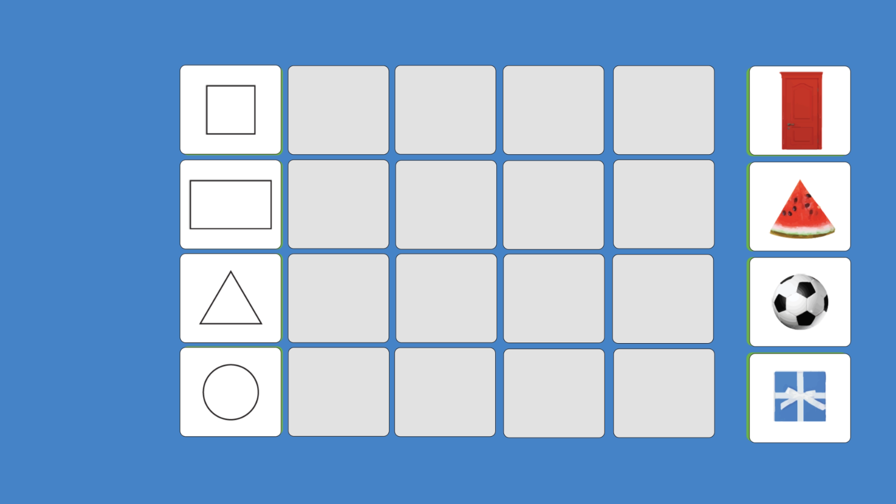

Playbooks to guide practitioners on use
The R4P website (WIP) – housing all material created as open source, freely downloadable and potentially zero rated
E-learning materials for whatsapp & other internal comms available with end users (organisation specific)
Short animations
Designed infographs (data-savvy)
Instructional videos in different languages

Slide 15
QUESTIONS?

