Slide 1

Chairman’s Report
National Early Childhood Development Alliance
Annual General Meeting
25 November 2020

Slide 2
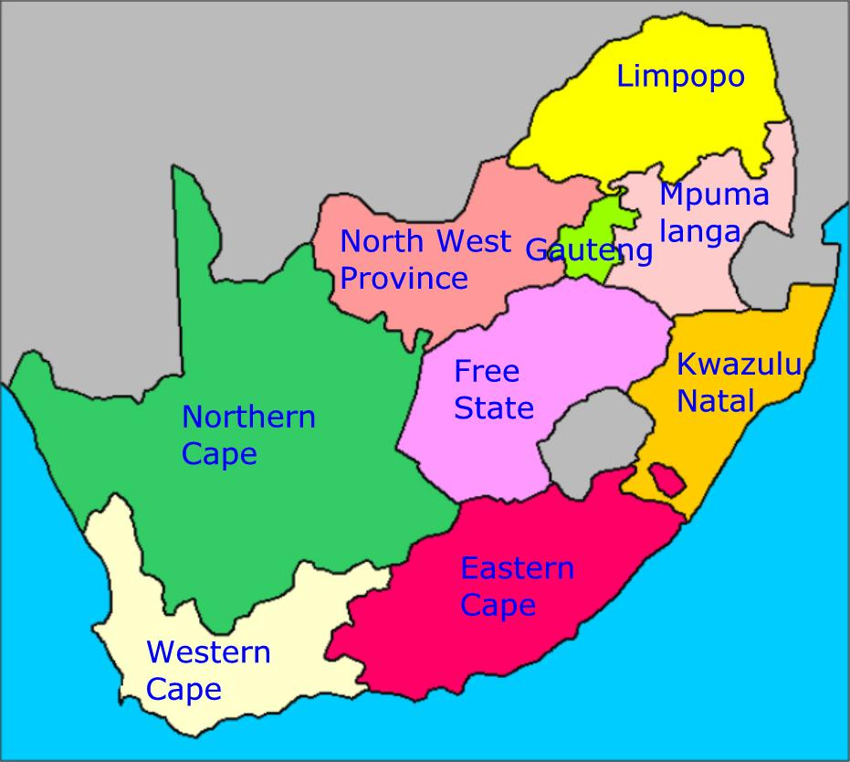
MEMBERSHIP MAP
MPUMALANGA MEMBERS
Ntataise Lowveld Trust
Penreach
Sithuthukile Trust
Siyathuthuka NSP
GAUTENG MEMBERS
Basadi Pele Foundation
BRIDGE
Bright Kid Foundation
Cotlands
COUNT
Curriculum Development Project
Diketso Inclusive
Dorothy August- Prolific Training
Edutak
Ekukhanyeni
Gauteng BAOBAB ECTP
HOPE SA
Inclusive Education South Africa
JAM South Africa
KELRU
Moltena
Motheo Training
Nova Institute
Play with Purpose
Phronesis SDT
READ
Safe and Sound
SAIDE
Siyakholwa
Smart Start
Takalani Sesame – Erika Jooste
Teachers Learning Centre
Tharallo Library
The Early Care Foundation
The Topsy Foundation
Ububele
FREE STATE MEMBERS
Boitjhorisong RC
Lesedi Educare Association
Ntataise Trust
Ntsoanatsatsi Educare Trust
Realeboga-Bakubung TDA
Tshehang Development and Training
Tshepang Trust
WESTERN CAPE MEMBERS
Ashley Kriel Development C
Early Learning Resource Unit
Early Years Services
Eltena Rethman-Online Giving
Fathima Rawat
Foundation Community Work
Geraldine Nichol
Gillian Van Wyk
Grassroots Educare Trust
Grow Educare
Ikamva Labantu
Inceba Trust
Jill Sachs
Johannes Erasmus
Klein Karoo
Knysna Education Trust
LID Pam Picken
Linda Biersteker
Lucy Thornton
Mikhulu Trust
Nalibali
ORT SA Cape
Pebbles Project
Persona Dolls
Sikhula Sonke
The Learning Initiative
The Love Trust
True North Consulting
University of Cape Town
VPUU
Wordworks
KWAZULU NATAL MEMBERS
Africa Ignite
Dhlalanathi
Disability Action Research Team
DO MORE Foundation
ELET
Feed the Babies Fund
iThemba Projects
KZN Experimental College
LETCEE
Midlands Community College
New Beginnings
NELRU
Rani Pillay
Singakwenza Edu and Health
Siyakwazi
TREE
Unlimited Child
Zero2Five Trust
EASTERN CAPE MEMBERS
Bulungula Incubator
CSD-Rhodes Un
Early Inspiration
ITEC
Khululeka CEDC
Loaves & Fishes
Masakhane Trust
Masikhule ECDC
REC
SAMA
Ubunye Foundation
Ubuntu Care
Elly Kew
ICDP Trust
NORTHERN CAPE MEMBERS
Custoda Trust
Bulungula Incubator
NORTH WEST
Tsiboganag CAG
2. Royal Bafokeng Institute
LIMPOPO MEMBERS
Golang Kulani ELC
Khanimamba
Thukakgaladi IDP
Thusanang Trust

Slide 3
New Members
Western Cape
Elthena Rethman – Online Giving
Fathima Rawat
Geraldine Nichol Individual
Gillian Van Wyk
GROW Educare
Inceba Trust
Jill Sachs
Johannes Erasmus
Lucy Thornton
Nalibali
Pebbles Project
The Love Trust
VPUU
North West
Tsiboganag CAG
Royal Bafokeng Institute
Gauteng
Dorothy August – Prolific Training
Ekukhanyeni
HOPE SA
Moltena
Nova Institute
Phronesis SDT
READ
Siyakholwa
Takalani Sesame – Erika Jooste
Kwazulu Natal
Africa Ignite
Disability Action Research Team
Feed the Babies the Fund
New Beginnings
Rani Pillay
Unlimited Child
Zero2Five
Eastern Cape
      REC
      Elly Kew
      ICDP Trust

Slide 4
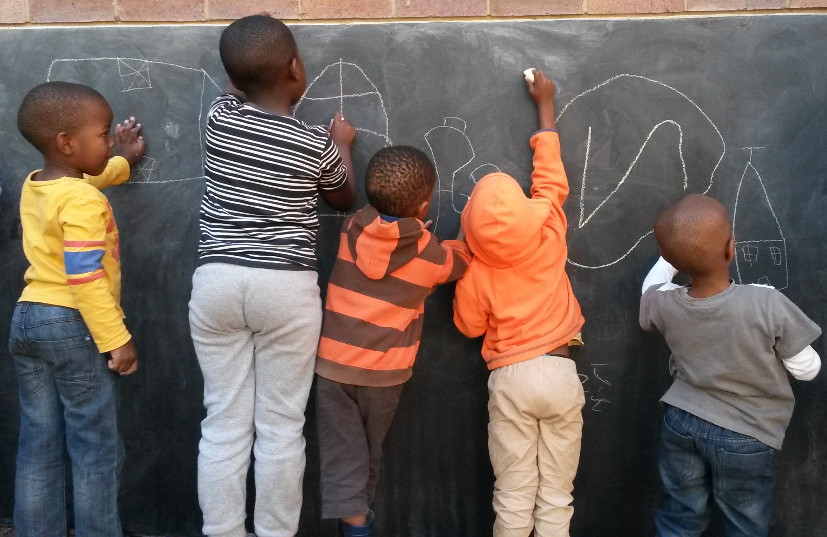
NECDA BOARD
Rene King – CHAIRPERSON (Executive Director: Khululeka Community Education Development Centre)
Monica Stach – VICE CHAIRPERSON (Chief Executive Officer: Cotlands)
Caroll Warmberg - TREASURER (Managing Director: ITEC)
Riedewhaan Allie – ADDITIONAL MEMBER (Director: Foundation for Community Work)
Puleng Motsoeneng – ADDITIONAL MEMBER (Director: Ntataise Trust)
Rex Molefe – ADDITIONAL MEMBER (Director: Motheo Training Institute)
Ruby Motaung – ADDITIONAL MEMBER (Director: TREE)
Abigail Crawford – NECDA BOARD SECRETARIAT

Slide 5
Advocacy, Lobbying and Networking
ECD Function Shift
Collaboration of ECD Networks (CECDN) National and Provincial Dialogues
Themes of Engagement
Policy and legislation
Training and curriculum
Registration and infrastructure
Communication and advocacy
Finance and ECD donors
Monitoring and evaluation
Health and nutrition
Social protection
Human Resources/Workforce
Process
National Dialogue with key stakeholders to frame the process
Delivery of Provincial dialogues between August and October 2019
822 stakeholders reached
Network partners compiled a full report of dialogue proceedings and recommendations on each of the themes
Report dissemination
Issues raised at Department of Education’s stakeholder deliberations in December 2019 and February 2020

Slide 6
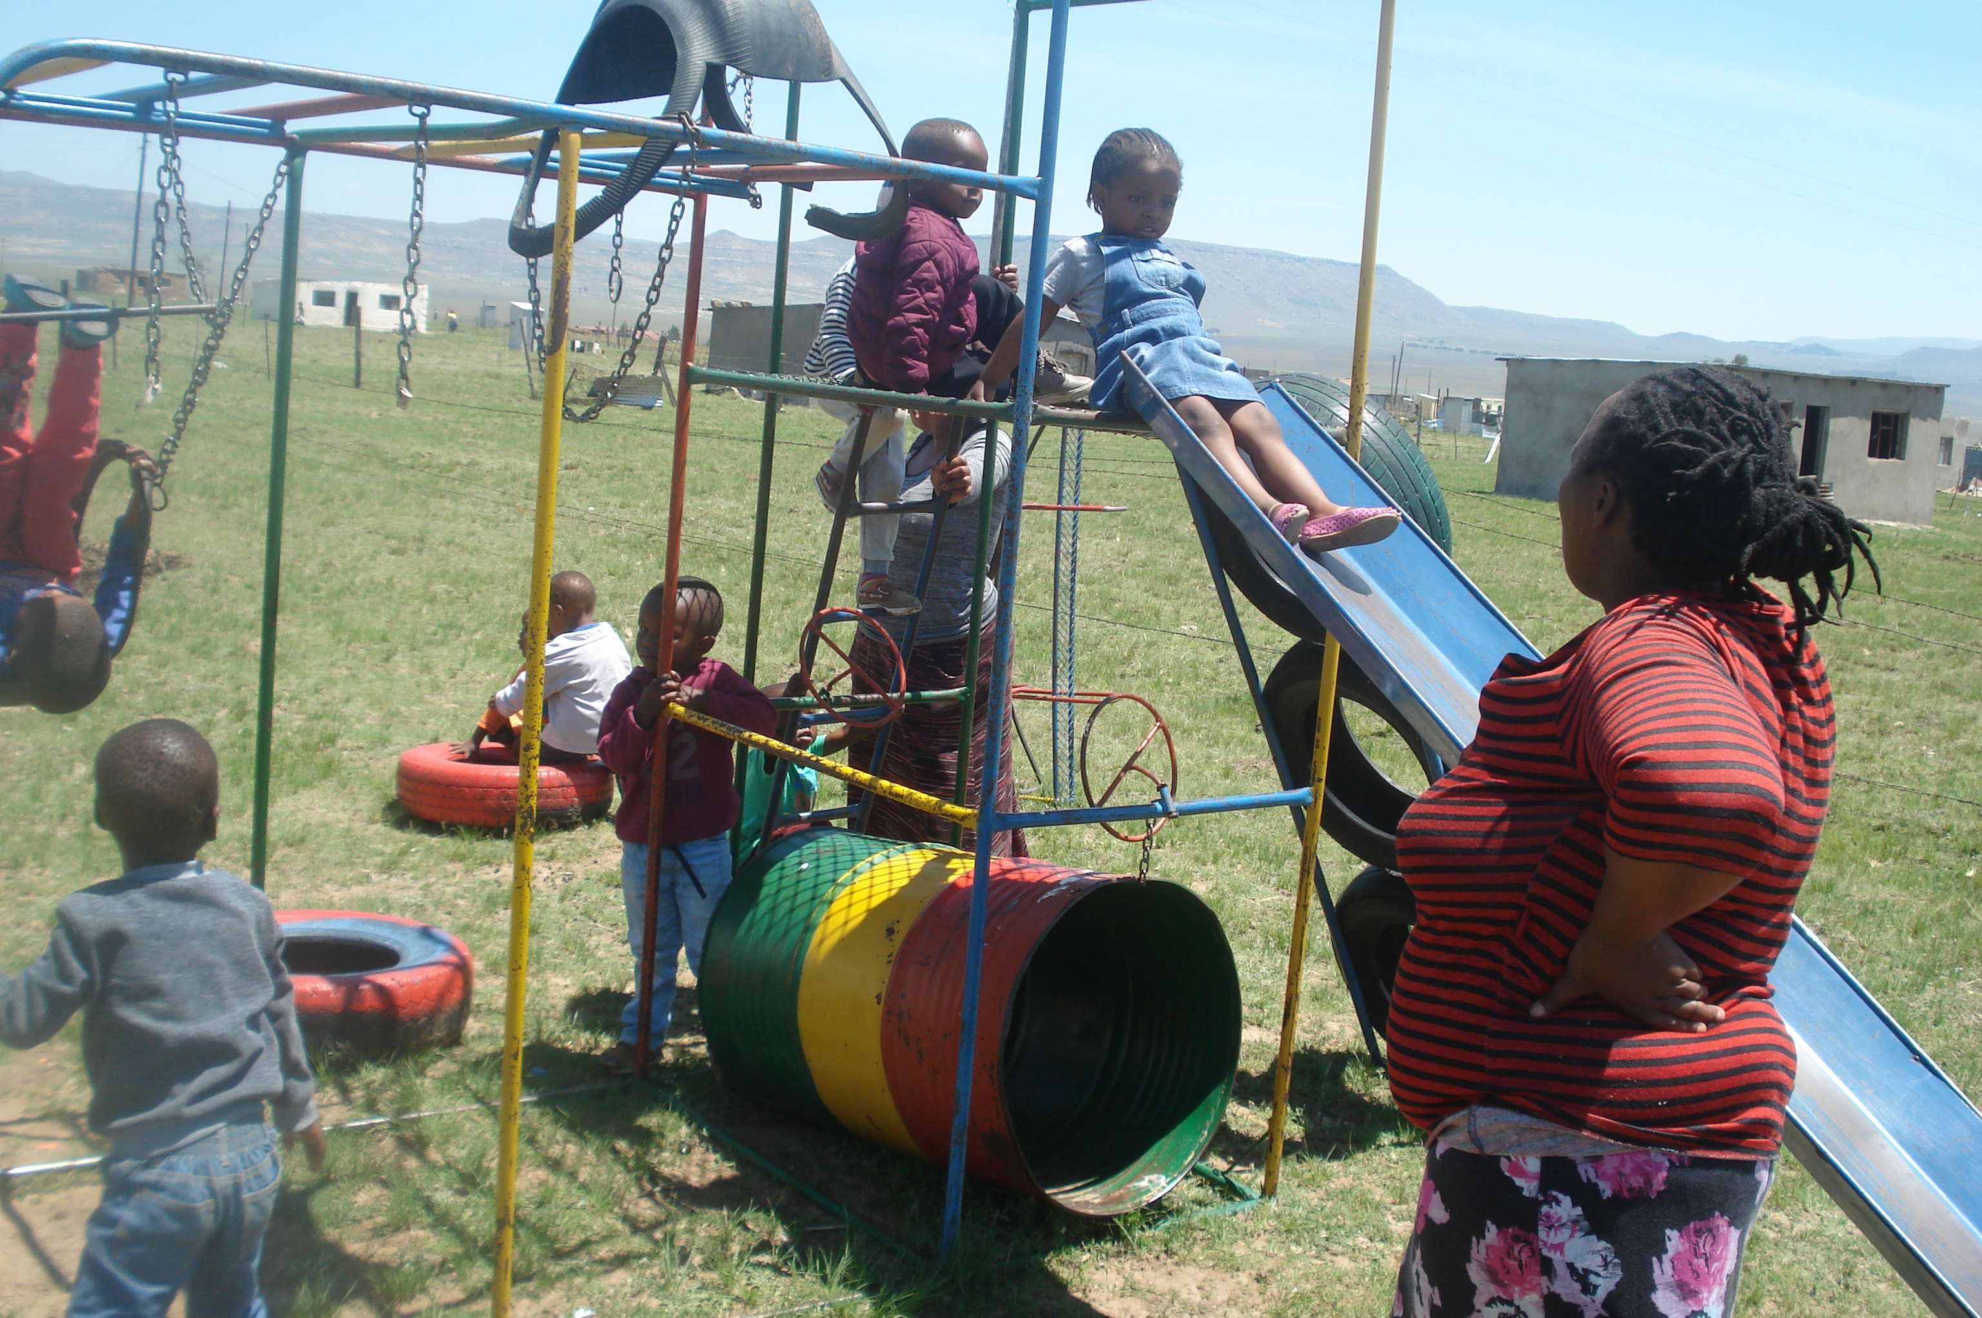
ECD Intersectoral Forum
The ECD Intersectoral Forum hosted by the National Department of Social Development was established to facilitate the implementation of the National Integrated ECD Policy 2015 and has created Work Stream sub-committees.
The development of protocols and procedures for the re-opening of ECD sites
The development of a proposal to Treasury for an Economic Stimulus Package for the ECD Workforce
Real Reform for ECD Campaign
Endorsed by NECDA
Presentation to follow

Slide 7
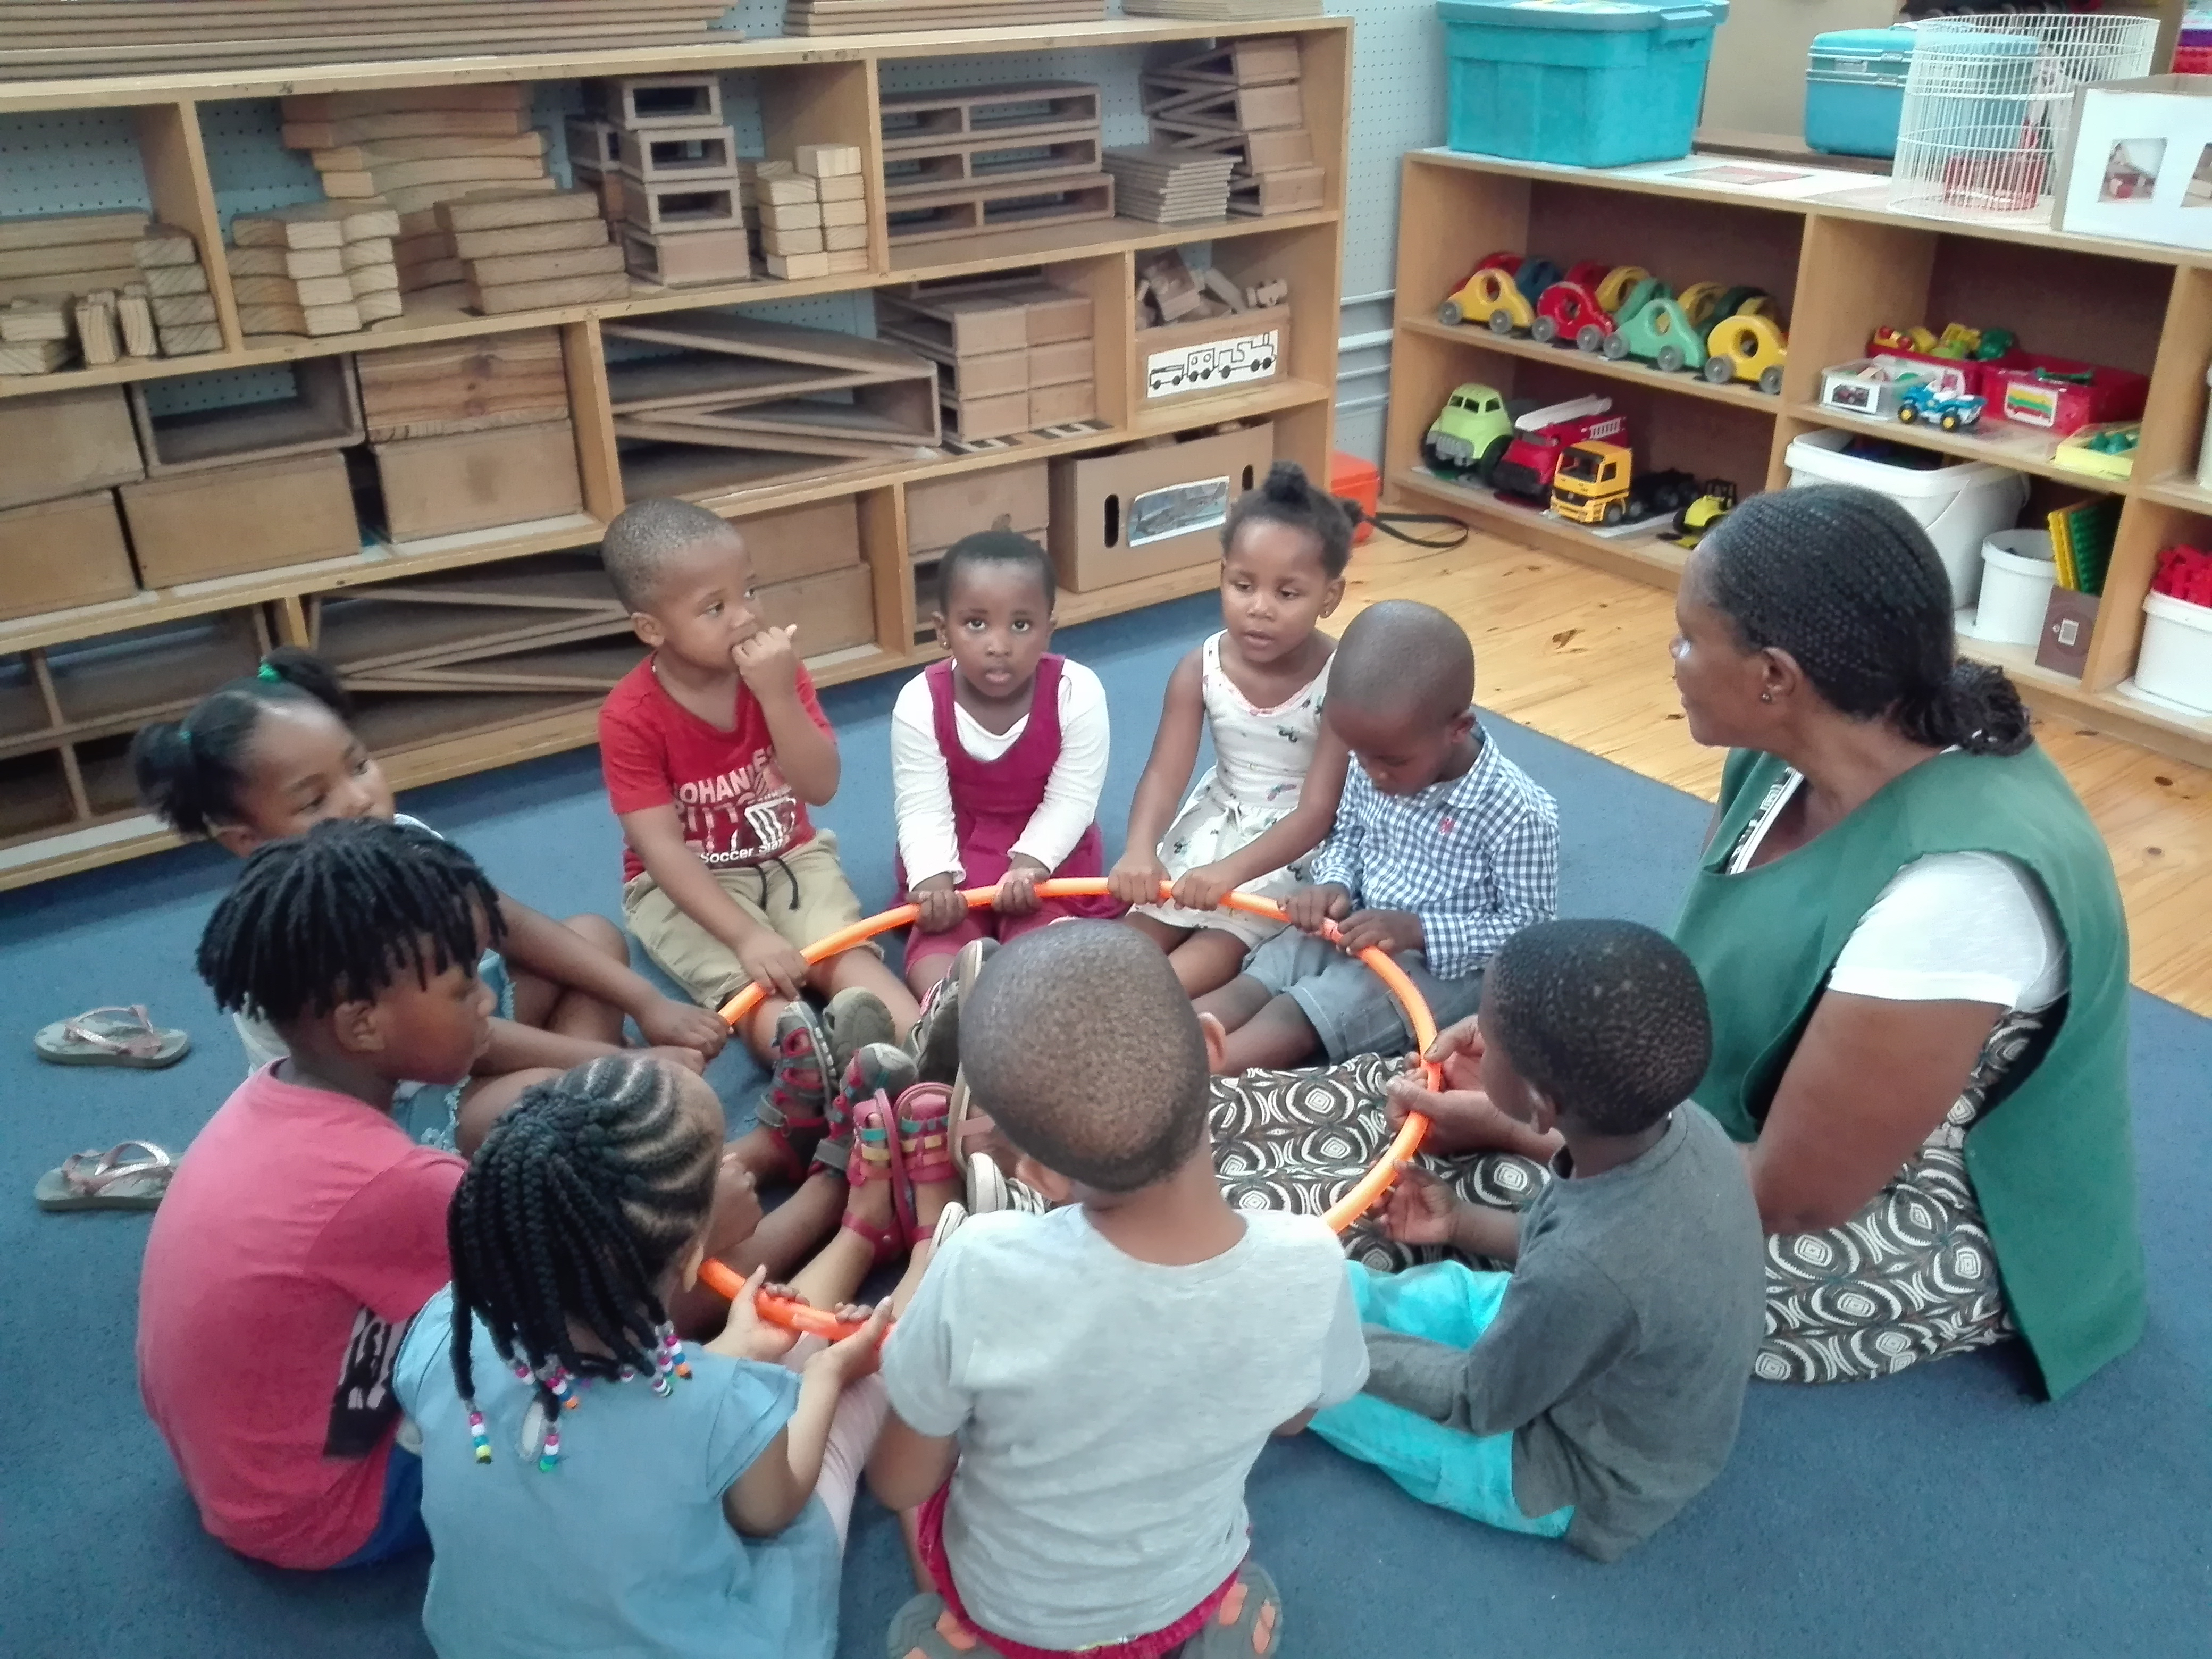
Capacity-Building Programmes
Provincial Workshops on the DHET Registration Process and WaziECD Maps data collection systems attended by 38 Member Organisations and 74 Participants (October 2019)
Training of Trainers for the FETC in ECD (Level 4) attended by 8 participants from 3 Member Organisations (November 2019)

Slide 8
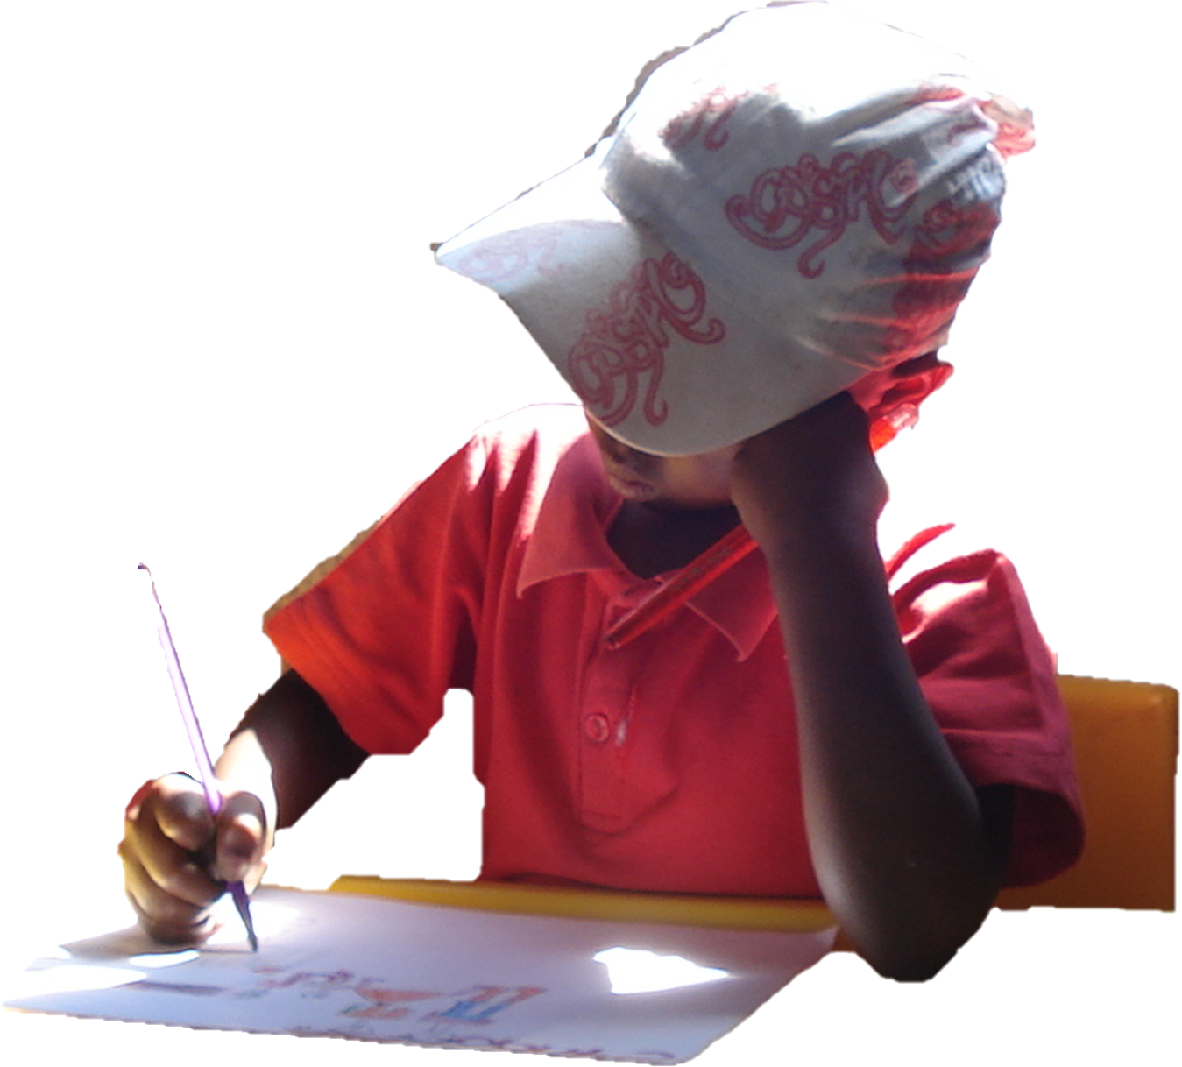
Special projects
Realignment of the NECDA materials for the ETDP SETA’s legacy Further Education and Training Certificate in ECD (Qualification ID 58761) in accordance with the new QCTO ECD Practitioner Qualification (ID 97542)
Development of Learner Support Materials for the National Curriculum Framework contracted by UNICEF on behalf of the Department of Social Development
NECDA/DoMore Foundation Purpose 4 RePurpose partnership

Slide 9
NECDA’s Response to Challenges presented by the COVID-19 Pandemic
Media and Communications
Monthly Newsletter
Distribution of resources
Dissemination of Information
ECD Practitioner Survey
ECD NGO Survey
Save our ECD Workforce Campaign
Television, radio and newspaper interviews
ECD Support Fund
Established in partnership with the South African Congress for ECD in May 2020
Hosted by NECDA but managed by an Independent Oversight Committee
Raised R 5 584 625 from multiple donors and individuals
Capacity to provide 1 018 ECD Practitioners with a 3 month income support enabling them to offer a service to approximately 10 181 young children in 407 ECD programmes in low resource settings
Over 4 000 applications currently being screened

Slide 10
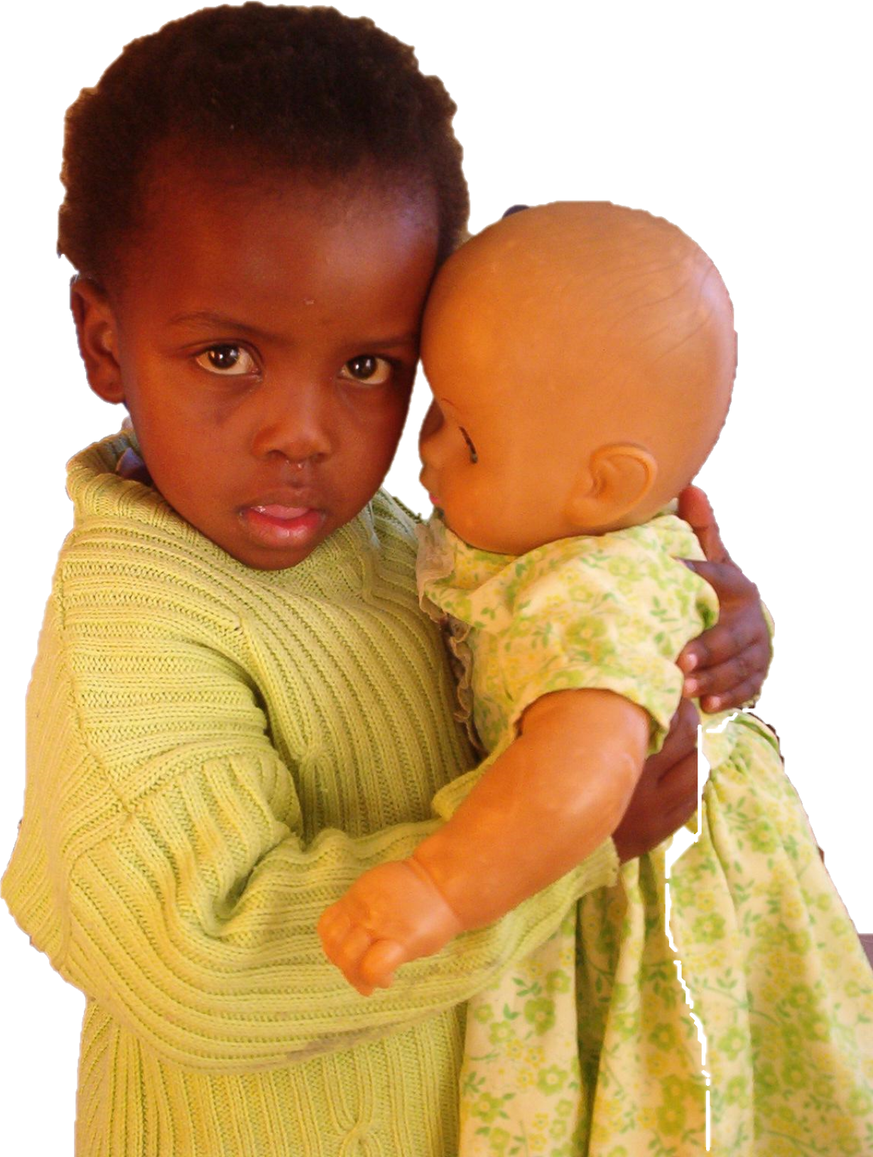
“Don’t worry that children never listen to you, worry that they are always watching you.”
In the end, best said in the words of Author, Robert Fulghum,

