Slide 1


Chairperson’s report 2021 to 2022
delivered by
Ruby Motaung on behalf of Monica Stach

Slide 2
Welcome
Welcome to the NECDA Board, the Members of the alliance, and our Funding Partners. Thank you for taking time out to attend the National ECD Alliance virtual Annual General Meeting.
Unfortunately, Monica has lost her voice and is not able to present her report, but it gives me great pleasure to deliver the report on her behalf.

Slide 3
Our strength
2020 RTO Survey in which:
34 Alliance Members participated, revealed that collectively they employed over
4 000 ECD Trainers and Assessors, were currently training
22 000 ECD Practitioners impacting upon over
half a million young children

Slide 4
Reflections
Covid-19
Looting and flooding
ECD Function shift and dialogues
Projects
Relationships
Debates
Notes:
When the board stepped into our roles in 2021, and I stepped into the chairperson’s role we were battling the third Covid wave with the National State of Disaster ending in April this year. The looting and floods added further to the distress our members experienced. The ECD function shift resulted in dialogues with the sector, raising more questions than answers. NECDA’s board worked tirelessly for 6 months to define NECDA’s strategy, whilst concluding current projects and securing additional projects. I am proud of the relationships the new board has forged during this period, and all the board achieved. Many a debate was had, resulting in governance and institutional changes with regards to managing the secretariat. My report outlines the activities of NECDA’s board, which I proudly present on their behalf.

Slide 5
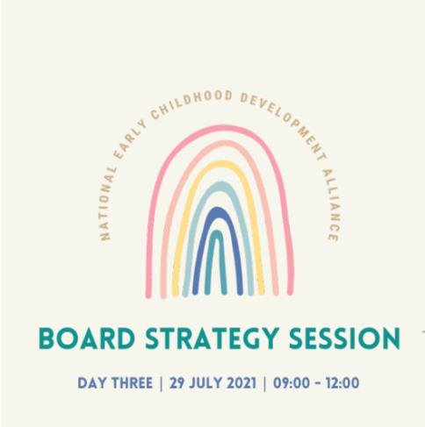
Strategic plan 2022 - 2024
Virtual strategic planning session
27-29 July 2021.
Facilitated by: The Barefoot Facilitator.
DGMT provided financial support
Mandate was derived from members
and included:
Review of the NECDA Constitution
Develop long term strategy
Capacity Building of the Membership
Growing the Secretariat

Slide 6
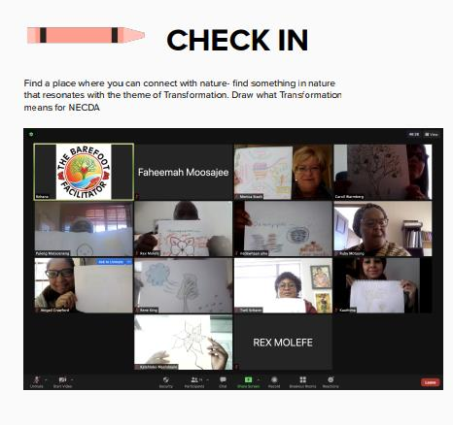
Strategic plan 2022 - 2024
The process empowered NECDA’s board to:
deepen our collective understanding of the respective strengths and interest of individual board members
deepen our collective understanding of the changing landscape and developments in the broader context that will impact our members and our organisational mandate
revisit and review our vision, mission and objectives in our constitution
co-create our strategic focus for the next three years, directing NECDA’s operations and the allocation of portfolios to board members

Slide 7
1. Lobbying and Advocacy, partnerships and government liaison

Slide 8
2. Information sharing

Slide 9
3. Skills development and capacity building

Slide 10
4. Administrative support and coordination

Slide 11
Membership
To date we have a 115 membership constituency registered across nine provinces of South Africa
In the spirit of good governance the board has had to take a decision to terminate dormant members with outstanding membership fees for a period of two years. We are anticipating reduction of 50 % leaving us with approximately 60 active members.
The NECDA office has commenced the process of termination and are appealing to all members to ensure you are in good standing.
Your fees enable the secretariat to function optimally.
We are excited to share and showcase the NECDA Membership Management System later today. This has been a long term project supported by Redefine Software which finally be of great value to the network and ensure NECDA is playing the digital space.

Slide 12
Capacity building initiatives
A. 25 November 2021: NPO Amendment Bill facilitated by Nicole Copley –
36 members attended
B. 1 Dec 2021: ETDP SETA Skills Development workshop facilitated by Mr Rex Molefe-
- 25 members attended
C. 1-11th April 2022: Skills Audit Survey
- 10 members responded
Skills management has become an indispensable element of an organisations performance. As the function shift aim to professionalise the ECD sector NECDA’s skills development and capacity building portfolio launched an online skills survey.
D. 11th May 2022
The parenting webinar planned for May has been rescheduled to July

Slide 13
Advocacy
1. NECDA members were represented at the NECT - DBE dialogues, working with the Collaboration of ECD Networks (CECDN) and published comments on the DBE’s ECD HR Strategy.
2. NECDA members representation and participation in the ECD Real Reform advocacy initiatives.
3. Our relationship with CECDN, has strengthened NECDA’s relationships with
the national ISF, SA ECD Congress and BRIDGE.
4. NECDA was represented by the chairperson at the KZN ECD Indaba.
5. A learning brief was authored by NECDA providing practical steps on practitioner training in relation to the results from the Thrive by Five study.
5. NECDA supported the ECD Census.
6. The chairperson participated in a collaborative and consultative partnership
Think tank with NWU and ETDP SETA on issues related to ECD practitioner
Training.

Slide 14
Marketing and information sharing
Media and Communications efforts continued through the:
• Monthly Newsletter
• Distribution of resources
• Dissemination of Information
• Television, radio and newspaper interviews or articles.

Slide 15
Projects
1. Training and Curriculum: Realignment of the NQF Level 4 Materials – Rene King
2. KZN ECD Relief Project in partnership with NECT and UNICEF – Carol Warmberg
3. World Vision NECDA partnership funded by UNICEF – Puleng Motsoeneng

Slide 16
Conclusion
During the past months NECDA board members have so perfectly illustrated that together we are stronger. I want to share this poem by Monet Echo, written in 2018:
A Feather... Or a Wing
When alone It drifts silently to the dust When joined It soars through violent wind gusts When alone It is frail, and if pressured, will break When together Not one will you easily take When alone It is considered extremely light When connected They carry an eagle in flight When alone A feather is still a unique and beautiful thing But when united They transform into a stunning, powerful wing
My heartfelt gratitude to every NECDA board member for the many hours of work over and beyond attending board
meetings. Together we braved the gusts of wind, we collaborated and taken NECDA to new heights. I am so proud of
all we have achieved.

Slide 17
Contact details
Dr Monica Stach
NECDA chairperson
monicas@cotlands.org

